Slide 1

Matchwise
Matches made in Heaven powered by GenAI
Matchwise
Matches made in Heaven powered by GenAI

Slide 2

21%
Out of 48 workings weeks. 10 are unused
Notes:
21 % of consulting hours are not billable due to sub optimal resource allocation, staff waiting makes out 10 weeks a year

Slide 3
Today’s Matchmaking Process is Broken
Availability isn‘t compatability
Staffing feels like a Scavenger Hunt
Idle Talent.
Delayed Projects
Money
Rigid rules block dynamics
Who’s available
beats
who’s qualified

Slide 4
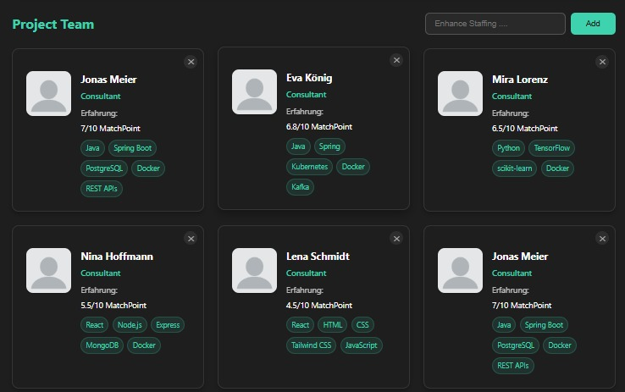
Find best fitting Profiles in Seconds
AI Powered MM
Import Project Scope
Initiate Matchmaking
Review Suggestions
Trigger Staffing
1-Click Deploy

Slide 5
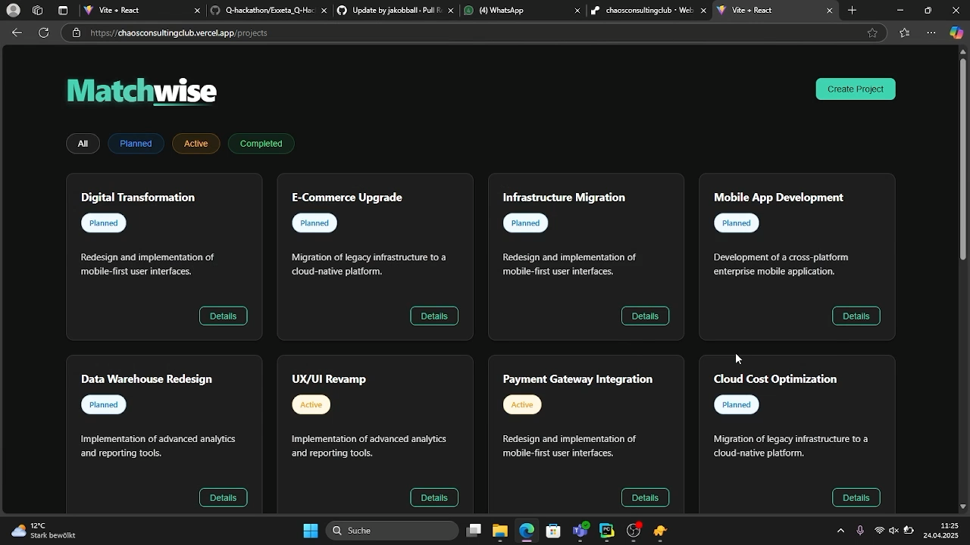

Slide 6
Market Size | A 10 Billion Dollar Opportunity
USD 319 Billion
USD 107 Billion
USD 11.52 Billion
Consulting Branche (Worldwide)
Consulting Market (EU)
Target Market
(EU)

Slide 7



Pricing Model
Enterprise
Custom
≥ 500 consultants
Business
35€ / user/
month
50-500
consultants
Enterprise
Custom
≥ 500 consultants
Entry
25€ / user/
month
≤ 50
consultants
Business
35€ / user/
month
50-500
consultants
Entry
20€ / user/
month
≤ 50 consultants

Slide 8
Funding Roadmap
Q
1
Exxeta Ventures / finalize MVP
Pre-Seed Round / go to market
2
3
Seed Round / VC / maturity
4
Exxeta Internal Pilot Project
Mid-Market Consultancies
5
6
Niche Advisory Firms

Slide 9
Matchwise Matches made in Heaven powered by GenAI
The best teams don’t wait.
Neither should your staffing.

